Slide 1
Introduction to Modern Computer Graphics
Curves and surfaces(a)

Slide 2
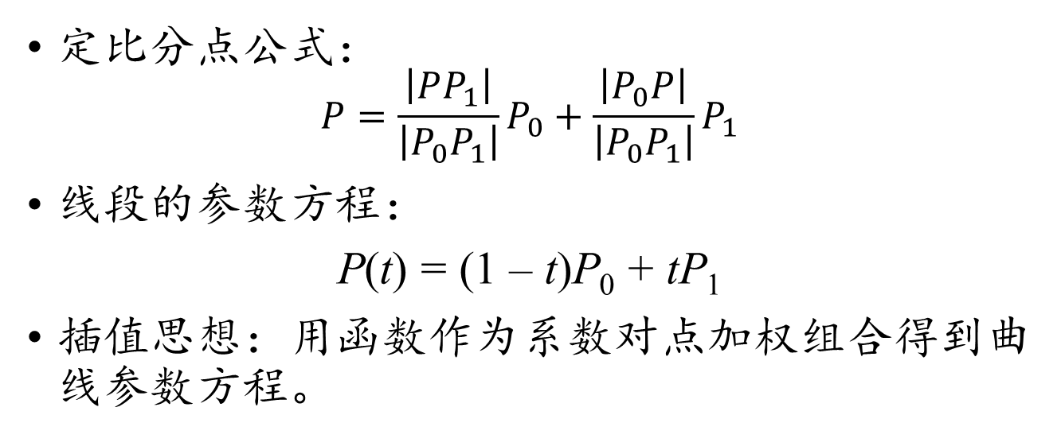
参数曲线的插值构造思想
定比分点公式：
$$P=\frac{\left|PP_{1}\right|}{\left|P_{0}P_{1}\right|}P_{0}+\frac{\left|P_{0}P\right|}{\left|P_{0}P_{1}\right|}P_{1}$$
线段的参数方程：
P(t) = (1 – t)P₀ + tP₁
插值思想：用函数作为系数对点加权组合得到曲线参数方程。

Slide 3
控制点和样条基函数
一般的样条曲线P(t) = (x(t), y(t))^{T}通常由若干个可以调整的点和对应带参数的权重加权组合构成：
P(t) = f₀(t)P₀ + f₁(t)P₁ + … + f_{n}(t)P_{n}
可以调整的点P_{i}, i = 0, 1, …, n称为(间接)控制点
带参数的权重f_{i}(t), i = 0, 1, …, n称为样条基函数
样条基函数f_{i}(t)的连续度和性质决定了样条曲线P(t)的特征

Slide 4
仿射变换及其性质
A是一个n×n矩阵，b∈R^{n}，下面R^{n}中的点之间的映射称为仿射变换：
T(p) = Ap + b
设p₁, p₂∈R^{n}，q₁, q₂∈R^{n}，且p₂ – p₁∥q₂ – q₁，则仿射变换有如下性质：
平行不变性质：
T(p₂) – T(p₁) ∥ T(q₂) – T(q₁)
单比不变性质
|T(p₂)T(p₁)||q₁q₂| = |T(q₂)T(q₁)||p₁p₂|

Slide 5
仿射变换的本质
T(p) = Ap + b
统一的形变A，加整体的平移b
玻璃板上的图案被平行光束投影到另一平面上

Slide 6
仿射不变条件
P_{i} = (x_{i}, y_{i}, z_{i})^{T}, P(t) = (x(t), y(t), z(t))^{T}
P(t) = f₀(t)P₀ + f₁(t)P₁ + … + f_{n}(t)P_{n}
两边同时作仿射变换，要求无论A和b怎样选择，仿射变换以后等式依然成立，则有
AP(t) + b = f₀(t)(AP₀ + b) + (f₁(t)AP₁ + b)
+ … + f_{n}(t)(AP_{n} + b)
AP(t) + b = A(f₀(t)P₀ + f₁(t)P₁ + … + f_{n}(t)P_{n})
+ (f₀(t) + f₁(t) + … + f_{n}(t))b

Slide 7
仿射不变条件
AP(t) + b = A(f₀(t)P₀ + f₁(t)P₁ + … + f_{n}(t)P_{n})
+ (f₀(t) + f₁(t) + … + f_{n}(t))b
样条曲线满足仿射不变性当且仅当
f₀(t) + f₁(t) + … + f_{n}(t) = 1
样条基函数满足和为1的条件称为权性质，这是构造样条基函数的基本要求
在几何运算中，对点做线性组合运算，也要求线性组合系数之和为1

Slide 8
仿射不变条件
对于样条基函数f₀(t), f₁(t), …, f_{n}(t) 构造
g(t) = 1 – f₀(t) – f₁(t) – … – f_{n}(t)
则有
P(t) = f₀(t)P₀ + f₁(t)P₁ + … + f_{n}(t)P_{n} + g(t)O
如果g(t) ≠ 0，则相当于让原点O也成为了样条的控制点，
当其它控制点平移时，O不平移，导致曲线不能满足仿射不变性质

Slide 9
仿射变换的性质
两条直线的平行关系不变
同一条直线上的线段比例不变
两个闭合图形的面积比例不变

Slide 10
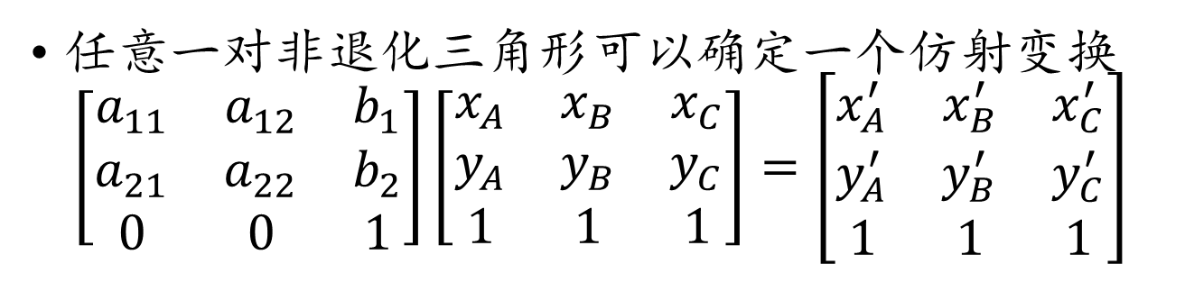
仿射变换的确定
A
C’
A’
B
C
B’
任意一对非退化三角形可以确定一个仿射变换
$$\left[\begin{matrix}a_{11} & a_{12} & b_{1} \\ a_{21} & a_{22} & b_{2} \\ 0 & 0 & 1\end{matrix}\right]\left[\begin{matrix}x_{A} & x_{B} & x_{C} \\ y_{A} & y_{B} & y_{C} \\ 1 & 1 & 1\end{matrix}\right]=\left[\begin{matrix}x_{A}^{′} & x_{B}^{′} & x_{C}^{′} \\ y_{A}^{′} & y_{B}^{′} & y_{C}^{′} \\ 1 & 1 & 1\end{matrix}\right]$$

Slide 11
四边形最小外接椭圆问题
给定四点，如何构造面积最小的椭圆？
转化为比值：椭圆面积最小，即椭圆面积与四边形面积比值最小
仿射变换：对角线交点分割比例确定的四边形，构造与四边形面积之比最小的椭圆
简化问题：在对角线分割比例确定的圆内接四边形中，寻找最合理的对角线夹角，使得四边形外接圆的面积与四边形的面积之比最小

Slide 12
四边形最小外接椭圆问题
A₀
D₀
P₀
C₀
B₀
设四边形A₀B₀C₀D₀内接于圆，对角线交于点P₀
根据圆幂定理，有
|P₀A₀|·|P₀C₀| = |P₀B₀|·|P₀D₀|

Slide 13
四边形最小外接椭圆问题
A₀
D₀
e^{u}
e^{– v}
P₀
θ
e^{– u}
e^{v}
C₀
B₀
设
∠P₀A₀B₀ = θ
|P₀A₀| = e^{u}, |P₀B₀| = e^{v}, |P₀C₀| = e ^{– u}, |P₀D₀| = e ^{– v}

Slide 14
四边形最小外接椭圆问题
A₀
D₀
P₀
θ
C₀
B₀
在ΔP₀A₀B₀和ΔP₀D₀A₀中使用余弦定理：
|A₀B₀|² = |P₀A₀|² + |P₀B₀|² – 2|P₀A₀|·|P₀B₀|cosθ
|A₀D₀|² = |P₀A₀|² + |P₀D₀|² + 2|P₀A₀|·|P₀D₀|cosθ

Slide 15
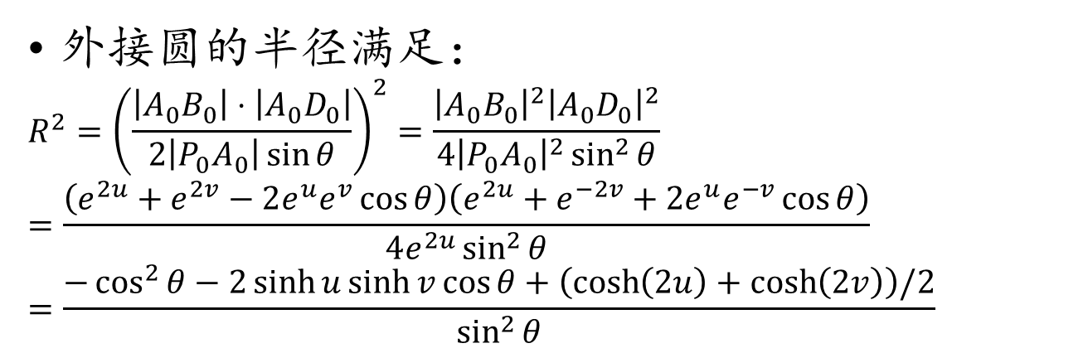
四边形最小外接椭圆问题
A₀
D₀
e^{u}
e^{– v}
P₀
θ
e^{– u}
e^{v}
C₀
B₀
外接圆的半径满足：
$$R^{2}={\left(\frac{\left|A_{0}B_{0}\right|⋅\left|A_{0}D_{0}\right|}{2\left|P_{0}A_{0}\right|\sin{θ}}\right)}^{2}=\frac{{\left|A_{0}B_{0}\right|}^{2}{\left|A_{0}D_{0}\right|}^{2}}{4{\left|P_{0}A_{0}\right|}^{2}\sin^{2}{θ}}$$
$$=\frac{\left(e^{2u}+e^{2v}−2e^{u}e^{v}\cos{θ}\right)\left(e^{2u}+e^{−2v}+2e^{u}e^{−v}\cos{θ}\right)}{4e^{2u}\sin^{2}{θ}}$$
$$=\frac{−\cos^{2}{θ}−2\sinh{u}\sinh{v}\cos{θ}+\left(\cosh\left(2u\right)+\cosh\left(2v\right)\right)/2}{\sin^{2}{θ}}$$

Slide 16
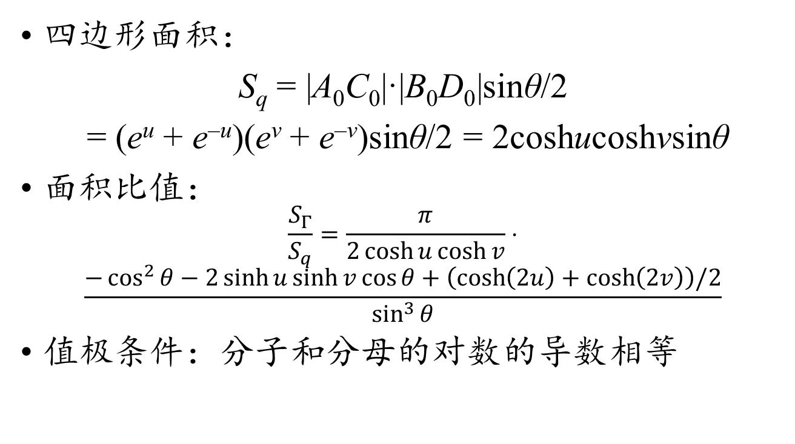
四边形最小外接椭圆问题
四边形面积：
S_{q} = |A₀C₀|·|B₀D₀|sinθ/2
= (e^{u} + e^{–u})(e^{v} + e^{–v})sinθ/2 = 2coshucoshvsinθ
面积比值：
$$\frac{S_{Γ}}{S_{q}}=\frac{π}{2\cosh{u}\cosh{v}}⋅$$
$$\frac{−\cos^{2}{θ}−2\sinh{u}\sinh{v}\cos{θ}+\left(\cosh\left(2u\right)+\cosh\left(2v\right)\right)/2}{\sin^{3}{θ}}$$
值极条件：分子和分母的对数的导数相等

Slide 17
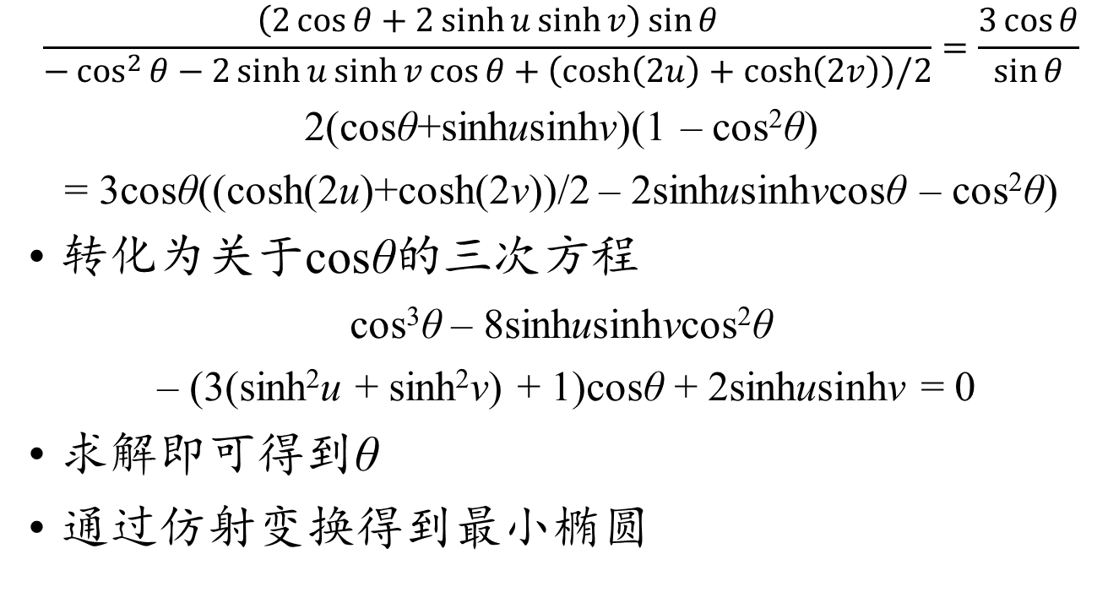
四边形最小外接椭圆问题
$$\frac{\left(2\cos{θ}+2\sinh{u}\sinh{v}\right)\sin{θ}}{−\cos^{2}{θ}−2\sinh{u}\sinh{v}\cos{θ}+\left(\cosh\left(2u\right)+\cosh\left(2v\right)\right)/2}=\frac{3\cos{θ}}{\sin{θ}}$$
2(cosθ+sinhusinhv)(1 – cos²θ)
= 3cosθ((cosh(2u)+cosh(2v))/2 – 2sinhusinhvcosθ – cos²θ)
转化为关于cosθ的三次方程
cos³θ – 8sinhusinhvcos²θ
– (3(sinh²u + sinh²v) + 1)cosθ + 2sinhusinhv = 0
求解即可得到θ
通过仿射变换得到最小椭圆

Slide 18
四边形最小外接椭圆问题
B₀
A
D
C₀
A₀
B
C
D₀
利用|P₀A₀|, |P₀B₀|, |P₀C₀|, |P₀D₀|和求解的θ构造圆内接四边形
通过构造仿射变换把四边形A₀B₀C₀D₀的外接圆转化为四边形ABCD的最小外接椭圆

Slide 19
Cubic Bézier Curve
User specifies 4 control points P₁ ... P₄
Curve goes through (interpolates) the ends P₁, P₄
Approximates the two other ones
Cubic polynomial
P(t) = (1 – t)³ P₀
+ 3t(1 – t)² P₁
+ 3t²(1 – t) P₂
+ t³ P₃
P₀
P₁
t = 0
P₂
t = 1
P₃

Slide 20
Cubic Bézier Curve
Curve is tangent at P₀ to (P₁ – P₀) and at P₃ to (P₃ – P₂)
P₁
P₁
P₂
P₃
P₀
P₃
P₀
P₂
P₁
Cubic Bezier Curve is always in the convex hull composed of the four control points
P₂
P₃
P₀

Slide 21
What’s with the Formula?
These are smart weights that describe the influence of each control point
It’s a linear combination of basis polynomials.
P(t) = (1 – t)³ P₀
+ 3t(1 – t)² P₁
+ 3t²(1 – t) P₂
+ t³ P₃
B₀(t)
B₃(t)
B₁(t)
B₂(t)

Slide 22
Weights
P(t) = (1 – t)³ P₀
+ 3t(1 – t)² P₁
+ 3t²(1 – t) P₂
+ t³ P₃
P(t) is a weighted combination of the 4 control points with weights:
B₁(t) = (1 – t)³
B₂(t) = 3t(1 – t)²
B₃(t) = 3t²(1 – t)
B₄(t) = t³
At t = 0, P₀ is the most influential point, then P₁, P₂, and P₃
B₀(t)
B₃(t)
B₁(t)
B₂(t)
P₁
P₃
P₀
P₂

Slide 23
What’s with the Formula?
Weights
It’s a linear combination of basis polynomials
The opposite perspective:
control points are the weights of polynomials!!!

Slide 24
Polynomials as a Vector Space
Polynomials
y(t) = a₀ + a₁t + a₂t² + … + a_{n}t^{n}
Can be added: just add the coefficients
Can be multiplied by a scalar: multiply the coefficients
In the polynomial vector space, {1, t, ..., t^{n}} are the basis vectors, a₀, a₁, ..., a_{n} are the components

Slide 25
Canonical Basis for Cubics
1
{1, t, t², t³}
Any cubic polynomial is a linear combination of these:
a₀ + a₁t + a₂t² + a₃t³
They are linearly independent
you can’t write any of the four monomials as a a linear combination of the others
t
t²
t³

Slide 26
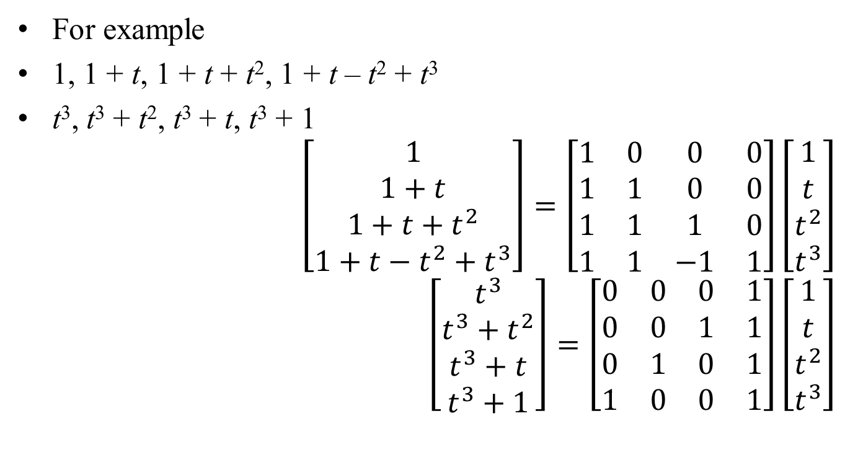
Different Basis
Canonical
Monomial
basis
For example
1, 1 + t, 1 + t + t², 1 + t – t² + t³
t³, t³ + t², t³ + t, t³ + 1
$$\left[\begin{matrix}1 \\ 1+t \\ 1+t+t^{2} \\ 1+t−t^{2}+t^{3}\end{matrix}\right]=\left[\begin{matrix}1 & 0 & 0 & 0 \\ 1 & 1 & 0 & 0 \\ 1 & 1 & 1 & 0 \\ 1 & 1 & −1 & 1\end{matrix}\right]\left[\begin{matrix}1 \\ t \\ t^{2} \\ t^{3}\end{matrix}\right]$$
$$\left[\begin{matrix}t^{3} \\ t^{3}+t^{2} \\ t^{3}+t \\ t^{3}+1\end{matrix}\right]=\left[\begin{matrix}0 & 0 & 0 & 1 \\ 0 & 0 & 1 & 1 \\ 0 & 1 & 0 & 1 \\ 1 & 0 & 0 & 1\end{matrix}\right]\left[\begin{matrix}1 \\ t \\ t^{2} \\ t^{3}\end{matrix}\right]$$
Change of
Basis matrix
These relationships
hold for each
value of t
Not any matrix will do!
If it’s singular, the basis
set will be linearly
dependent, i.e.,
redudant and incomplete

Slide 27
Bernstein Polynomials
For Bézier curves, the basis polynomials/vectors are Bernstein polynomials
≥ 0 for all 0 ≤ t ≤ 1
Sum to 1 for every t
Bézier curves lie within convex hull
Only B₀ is non-zero at 0
Bézier interpolates P₀
Same for B₃ and P₃ for t=1
B₀(t)
B₃(t)
B₁(t)
B₂(t)
B₀ + B₁ + B₂ + B₃ = 1

Slide 28
Bézier in Bernstein Basis
P(t) = P₀B₀(t) + P₁B₁(t) + P₁B₁(t) + P₁B₁(t)
P(t) is a linear combination of the control points with weights the Bernstein polynomials at t
But at the same time, the control points (P₁, P₂, P₃, P₄) are the “coordinates” of the curve in the Bernstein basis

Slide 29
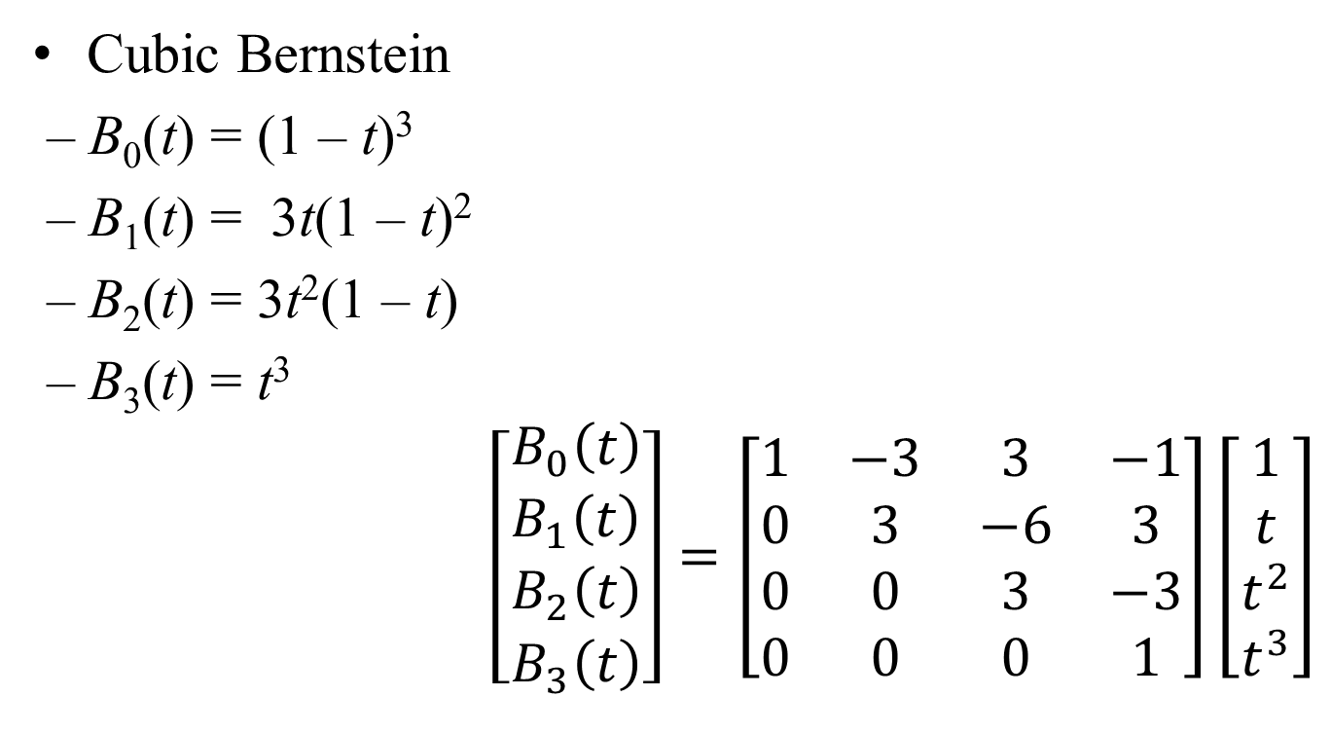
Change of Basis
Cubic Bernstein
– B₀(t) = (1 – t)³
– B₁(t) = 3t(1 – t)²
– B₂(t) = 3t²(1 – t)
– B₃(t) = t³
$$\left[\begin{matrix}B_{0}\left(t\right) \\ B_{1}\left(t\right) \\ B_{2}\left(t\right) \\ B_{3}\left(t\right)\end{matrix}\right]=\left[\begin{matrix}1 & −3 & 3 & −1 \\ 0 & 3 & −6 & 3 \\ 0 & 0 & 3 & −3 \\ 0 & 0 & 0 & 1\end{matrix}\right]\left[\begin{matrix}1 \\ t \\ t^{2} \\ t^{3}\end{matrix}\right]$$
Expand these out
and collect powers of t
The coefficients are the entries
in the matrix B

Slide 30
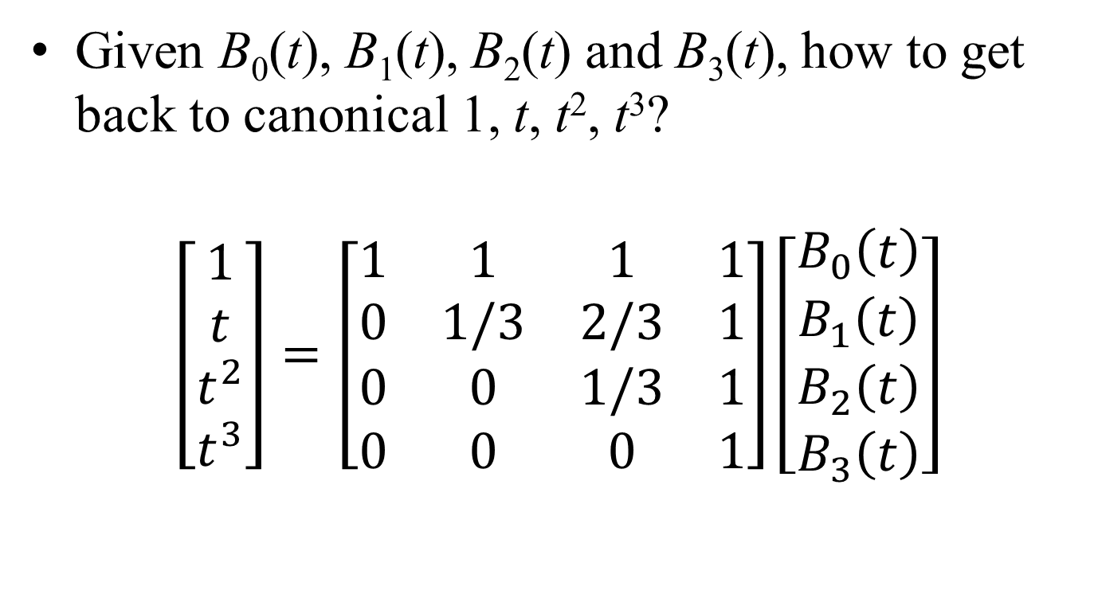
Change of Basis, Other Direction
Given B₀(t), B₁(t), B₂(t) and B₃(t), how to get back to canonical 1, t, t², t³?
$$\left[\begin{matrix}1 \\ t \\ t^{2} \\ t^{3}\end{matrix}\right]=\left[\begin{matrix}1 & 1 & 1 & 1 \\ 0 & 1/3 & 2/3 & 1 \\ 0 & 0 & 1/3 & 1 \\ 0 & 0 & 0 & 1\end{matrix}\right]\left[\begin{matrix}B_{0}\left(t\right) \\ B_{1}\left(t\right) \\ B_{2}\left(t\right) \\ B_{3}\left(t\right)\end{matrix}\right]$$

Slide 31
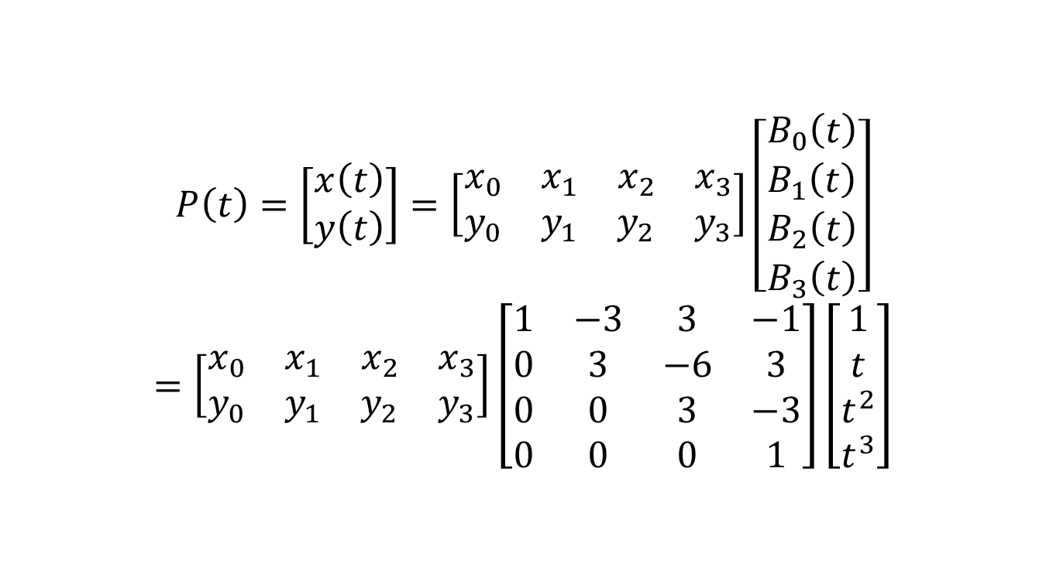
Cubic Bézier in Matrix Notation
$$P\left(t\right)=\left[\begin{matrix}x\left(t\right) \\ y\left(t\right)\end{matrix}\right]=\left[\begin{matrix}x_{0} & x_{1} & x_{2} & x_{3} \\ y_{0} & y_{1} & y_{2} & y_{3}\end{matrix}\right]\left[\begin{matrix}B_{0}\left(t\right) \\ B_{1}\left(t\right) \\ B_{2}\left(t\right) \\ B_{3}\left(t\right)\end{matrix}\right]$$
$$=\left[\begin{matrix}x_{0} & x_{1} & x_{2} & x_{3} \\ y_{0} & y_{1} & y_{2} & y_{3}\end{matrix}\right]\left[\begin{matrix}1 & −3 & 3 & −1 \\ 0 & 3 & −6 & 3 \\ 0 & 0 & 3 & −3 \\ 0 & 0 & 0 & 1\end{matrix}\right]\left[\begin{matrix}1 \\ t \\ t^{2} \\ t^{3}\end{matrix}\right]$$
Point on curve
(2×1 vector)
Bernstein Basis
Geometry matrix
Canonical
monomial basis

Slide 32
General Spline Formulation
Geometry: control points coordinates assembled into a matrix (P₁, P₂, …, P_{n+1})
Spline matrix: defines the type of spline
Bernstein for Bézier
Power basis: the monomials (1, t, ..., t^{n})
Advantage of general formulation
Compact expression
Easy to convert between types of splines
Dimensionality (plane or space) doesn’t really matter

Slide 33
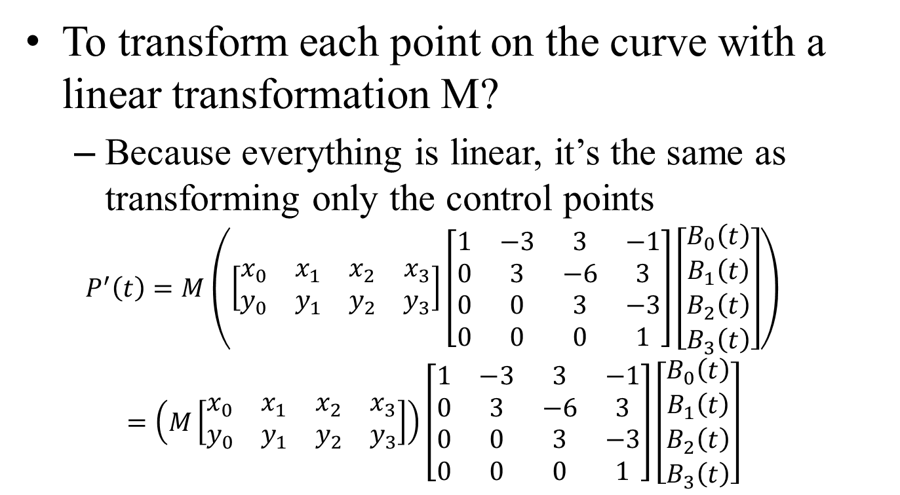
Linear Transformations & Cubics
To transform each point on the curve with a linear transformation M?
Because everything is linear, it’s the same as transforming only the control points
$$P^{′}\left(t\right)=M\left(\left[\begin{matrix}x_{0} & x_{1} & x_{2} & x_{3} \\ y_{0} & y_{1} & y_{2} & y_{3}\end{matrix}\right]\left[\begin{matrix}1 & −3 & 3 & −1 \\ 0 & 3 & −6 & 3 \\ 0 & 0 & 3 & −3 \\ 0 & 0 & 0 & 1\end{matrix}\right]\left[\begin{matrix}B_{0}\left(t\right) \\ B_{1}\left(t\right) \\ B_{2}\left(t\right) \\ B_{3}\left(t\right)\end{matrix}\right]\right)$$
$$=\left(M\left[\begin{matrix}x_{0} & x_{1} & x_{2} & x_{3} \\ y_{0} & y_{1} & y_{2} & y_{3}\end{matrix}\right]\right)\left[\begin{matrix}1 & −3 & 3 & −1 \\ 0 & 3 & −6 & 3 \\ 0 & 0 & 3 & −3 \\ 0 & 0 & 0 & 1\end{matrix}\right]\left[\begin{matrix}B_{0}\left(t\right) \\ B_{1}\left(t\right) \\ B_{2}\left(t\right) \\ B_{3}\left(t\right)\end{matrix}\right]$$

Slide 34
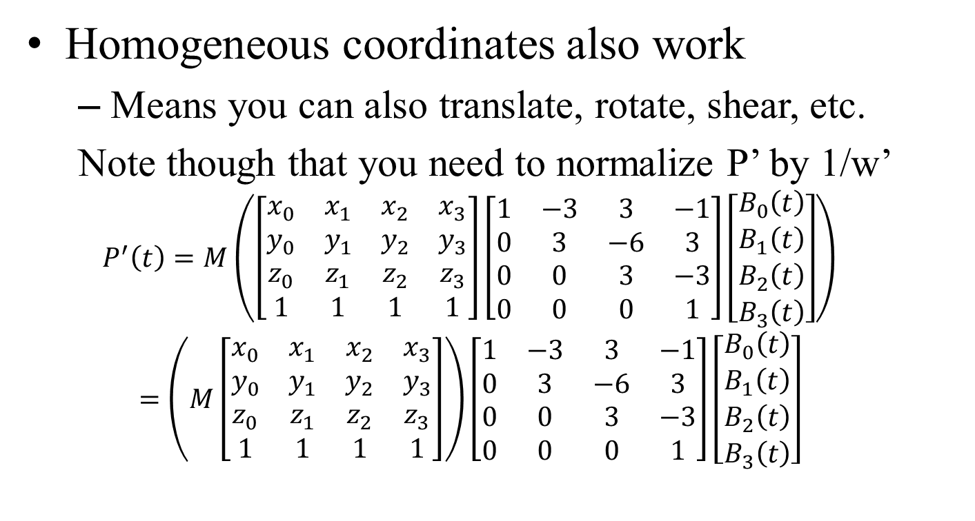
Projective Transformations
Homogeneous coordinates also work
Means you can also translate, rotate, shear, etc.
Note though that you need to normalize P’ by 1/w’ $$P^{′}\left(t\right)=M\left(\left[\begin{matrix}x_{0} & x_{1} & x_{2} & x_{3} \\ y_{0} & y_{1} & y_{2} & y_{3} \\ z_{0} & z_{1} & z_{2} & z_{3} \\ 1 & 1 & 1 & 1\end{matrix}\right]\left[\begin{matrix}1 & −3 & 3 & −1 \\ 0 & 3 & −6 & 3 \\ 0 & 0 & 3 & −3 \\ 0 & 0 & 0 & 1\end{matrix}\right]\left[\begin{matrix}B_{0}\left(t\right) \\ B_{1}\left(t\right) \\ B_{2}\left(t\right) \\ B_{3}\left(t\right)\end{matrix}\right]\right)$$
$$=\left(M\left[\begin{matrix}x_{0} & x_{1} & x_{2} & x_{3} \\ y_{0} & y_{1} & y_{2} & y_{3} \\ z_{0} & z_{1} & z_{2} & z_{3} \\ 1 & 1 & 1 & 1\end{matrix}\right]\right)\left[\begin{matrix}1 & −3 & 3 & −1 \\ 0 & 3 & −6 & 3 \\ 0 & 0 & 3 & −3 \\ 0 & 0 & 0 & 1\end{matrix}\right]\left[\begin{matrix}B_{0}\left(t\right) \\ B_{1}\left(t\right) \\ B_{2}\left(t\right) \\ B_{3}\left(t\right)\end{matrix}\right]$$

Slide 35
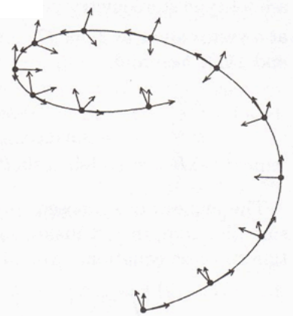
Differential Properties of Curves
Motivation
Compute normal for surfaces
Compute velocity for animation
Analyze smoothness

Slide 36
Velocity
First derivative w.r.t. t
Can you compute this for Bezier curves?
P(t) = (1 – t)³ P₀
+ 3t(1 – t)² P₁
+ 3t²(1 – t) P₂
+ t³ P₃
P’(t) = – 3(1 – t)² P₀
+ (3(1 – t)² – 6t(1 – t)) P₁
+ (6t(1 – t) + 3t²) P₂
+ 3t² P₃
P₀
P₁
t = 0
P₂
t = 1
P₃

Slide 37
Linearity
Differentiation is a linear operation
(f + g)’ = f’ + g’
(af)’ = af’
This means that the derivative of the basis is enough to know the derivative of any spline.
Can be done with matrices
Trivial in monomial basis
But get lower-order polynomials

Slide 38
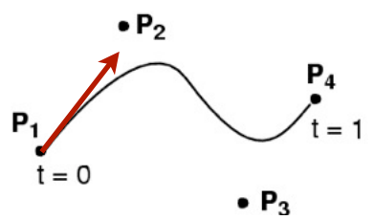
Tangent
The tangent to the curve P(t) can be defined as T(t) = P’(t)
normalized tangent T_{n}(t) = T(t) / ǁT(t)ǁ
This provides us with one orientation for swept surfaces later

Slide 39
平面曲线的切线和法线
切线的构造：割线一端沿着曲线滑动至与另一端重合
法线的构造：切线的垂线方向

Slide 40
曲线的曲率
δθ
δs
曲率的本质：沿着曲线移动单位长度，切线方向的变化量

Slide 41

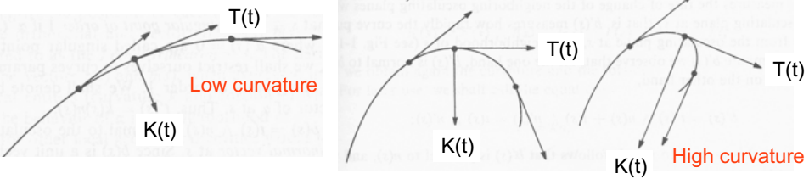
Curvature
Derivative of unit tangent
K(t)=T’(t)
Magnitude ǁK(t)ǁ is constant for a circle
Zero for a straight line
Always orthogonal to tangent, i.e.

Slide 42
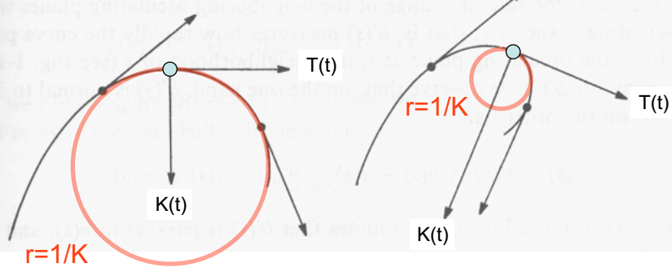
Geometric Interpretation
K is zero for a line, constant for circle
What constant? 1/r
1/ǁK(t)ǁ is the radius of the circle that touches P(t) at t and has the same curvature as the curve

Slide 43
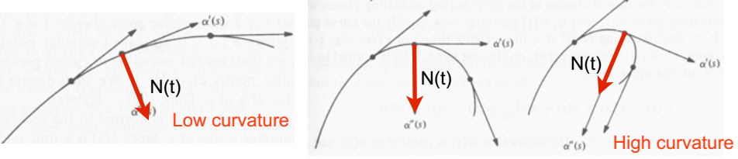
Curve Normal
Unit Norm: T_{n}’(t) / ǁT_{n}’(t)ǁ

Slide 44
曲线曲率的法向量解释
δs
δθ
把曲线每点的单位法向量初始端移到同一个位置，当点移动单位长度时，法向量末端划过的弧长

Slide 45
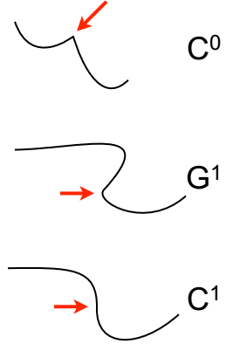
Orders of Continuity
C⁰ = continuous
The seam can be a sharp kink
G¹ = geometric continuity – Tangents point to the same direction at the seam
C¹ = parametric continuity
Tangents are the same at the seam, implies G¹
C² = curvature continuity
Tangents and their derivatives are the same

Slide 46
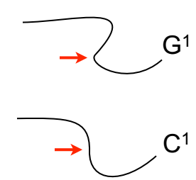
Orders of Continuity
G¹ = geometric continuity
Tangents point to the same direction at the seam
good enough for modeling
curve as set of points
C¹ = parametric continuity
Tangents are the same at the seam, implies G¹
often necessary for animation
curve as a mapping

Slide 47
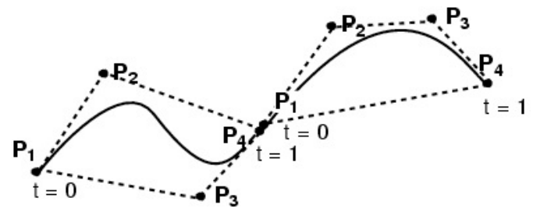
Connecting Cubic Bézier Curves
How can we guarantee C⁰ continuity?
How can we guarantee G¹ continuity?
How can we guarantee C¹ continuity?
C² and above gets difficult

Slide 48
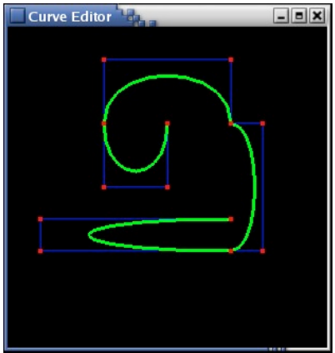
Connecting Cubic Bézier Curves
Where is this curve
C⁰ continuous?
G¹ continuous?
C¹ continuous?
What’s the relationship between:
the # of control points, and the # of cubic Bézier subcurves?

Slide 49
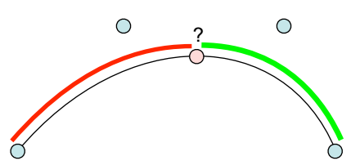
Subdivision of a Bézier Curve
Can we split a Bézier curve into two in the middle, using two new Bézier curves?
Would be useful for adding detail, as a single cubic doesn’t get you very far, and higher-order curves are nasty.

Slide 50
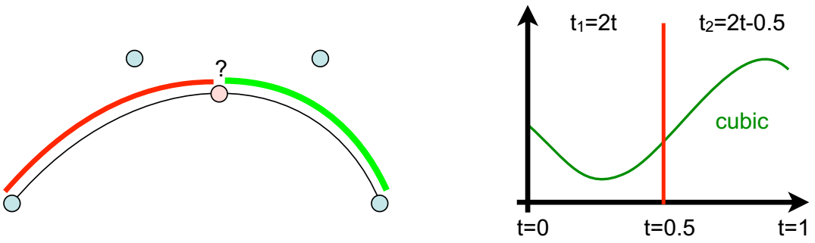
Subdivision of a Bézier Curve
Can we split a Bézier curve into two in the middle, using two new Bézier curves?
The resulting curves are again a cubic (Why? A cubic in t is also a cubic in 2t)
Hence it must be representable using the Bernstein basis. So yes, we can!

Slide 51
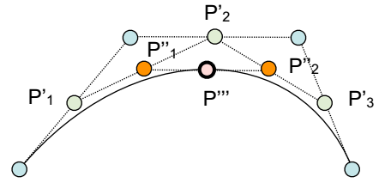
De Casteljau Construction
Take the middle point of each of the 3 segments
Construct the two segments joining them
Take the middle of those two new segments
Join them
Take the middle point P’’’

Slide 52
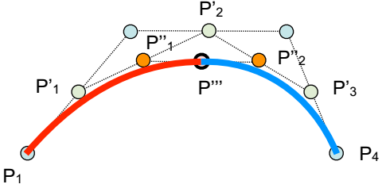
Result of Split in Middle
The two new curves are defined by
P₁, P’₁, P’’₁, and P’’’
P’’’, P’’₂, P’₃, and P₄
Together they exactly replicate the original curve! Originally 4 control points, now 7 (more control)

Slide 53
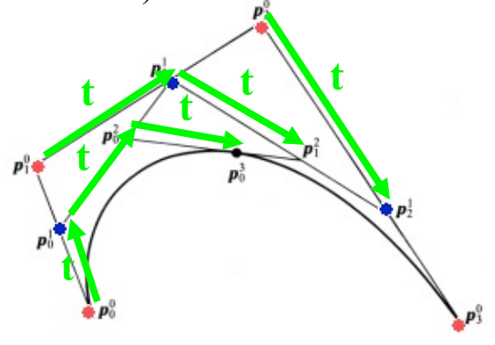
De Casteljau Construction
Actually works to construct a point at any t, not just 0.5
Just subdivide the segments with ratio (1 – t), t

Slide 54
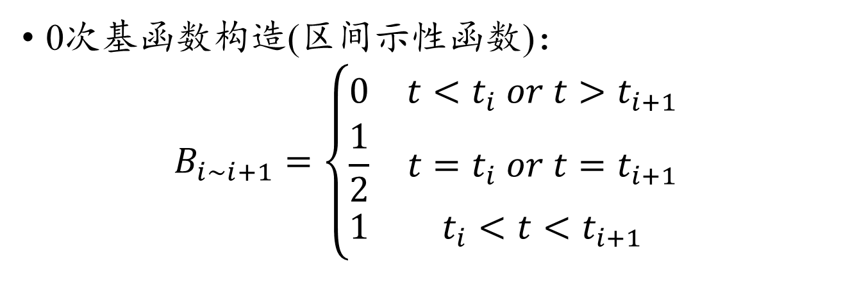
B样条基函数
t_{i}
t_{i + 1}
0次基函数构造(区间示性函数)：
$$B_{i\sim i+1}=\left\{\begin{matrix}0 & t<t_{i} or t>t_{i+1} \\ \frac{1}{2} & t=t_{i} or t=t_{i+1} \\ 1 & t_{i}<t<t_{i+1}\end{matrix}\right.$$

Slide 55
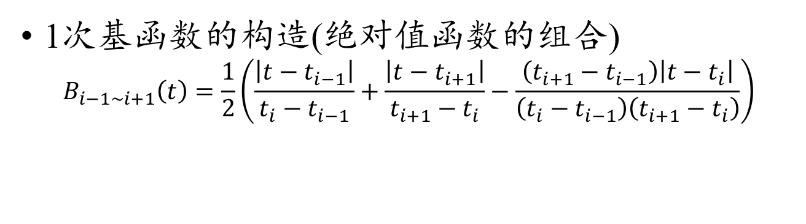
B样条基函数
t_{i–1}
t_{i}
t_{i+1}
1次基函数的构造(绝对值函数的组合)
$$B_{i−1\sim i+1}\left(t\right)=\frac{1}{2}\left(\frac{\left|t−t_{i−1}\right|}{t_{i}−t_{i−1}}+\frac{\left|t−t_{i+1}\right|}{t_{i+1}−t_{i}}−\frac{\left(t_{i+1}−t_{i−1}\right)\left|t−t_{i}\right|}{\left(t_{i}−t_{i−1}\right)\left(t_{i+1}−t_{i}\right)}\right)$$

Slide 56
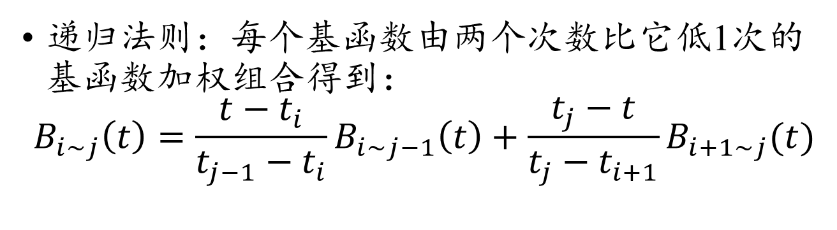
B样条基函数
t_{i}
t_{i + 1}
t_{j – 1}
t_{j}
递归法则：每个基函数由两个次数比它低1次的基函数加权组合得到：
$$B_{i\sim j}\left(t\right)=\frac{t−t_{i}}{t_{j−1}−t_{i}}B_{i\sim j−1}\left(t\right)+\frac{t_{j}−t}{t_{j}−t_{i+1}}B_{i+1\sim j}(t)$$

Slide 57
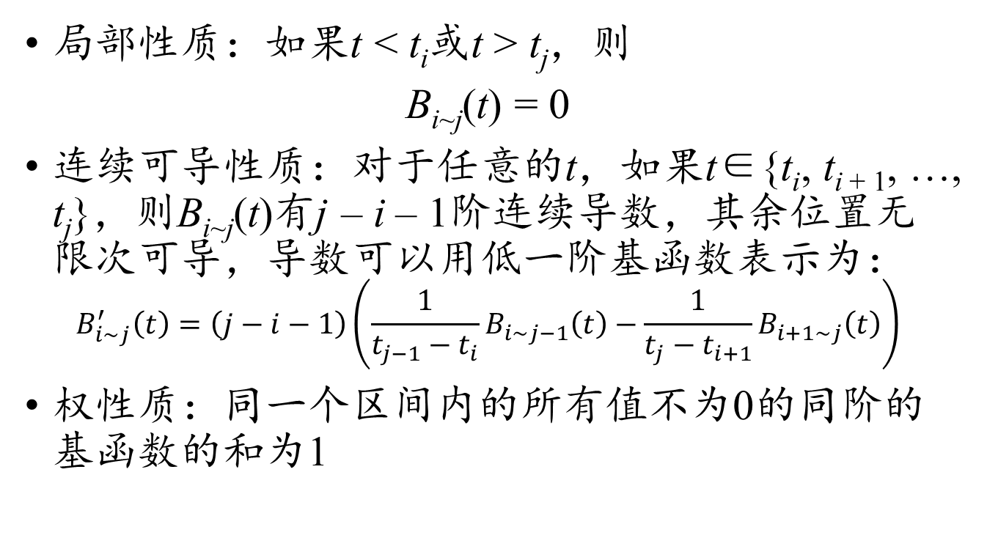
B样条基函数的性质
局部性质：如果t < t_{i}或t > t_{j}，则
B_{i~j}(t) = 0
连续可导性质：对于任意的t，如果t∈{t_{i}, t_{i + 1}, …, t_{j}}，则B_{i~j}(t)有j – i – 1阶连续导数，其余位置无限次可导，导数可以用低一阶基函数表示为：
$$B_{i\sim j}^{′}\left(t\right)=\left(j−i−1\right)\left(\frac{1}{t_{j−1}−t_{i}}B_{i\sim j−1}\left(t\right)−\frac{1}{t_{j}−t_{i+1}}B_{i+1\sim j}\left(t\right)\right)$$
权性质：同一个区间内的所有值不为0的同阶的基函数的和为1

Slide 58
三次B样条基函数
每段样条跨越4个区间，中间有3个结点
在中间结点附近取得极大值
在使用三次B样条插值时，每个控制点的参数作为中间结点来构造B样条

Slide 59
三次B样条曲线
对于控制点P₀, P₁, …, P_{n}，如果三次B样条插值的基本形式如下：
P(t) = P₀B_{–2~2}(t) + P₁B_{–1~3}(t) + … + P_{n}B_{n–2~n+2}(t)
由于P₀往左不再有结点，所以P₀处的参数t₀会让t_{–2}和t_{–1}重用
由于P_{n}往右不再有结点，所以P_{n}处的参数t_{n}会让t_{n+1}和t_{n + 2}重用
当几个相邻的结点重合时，B样条基函数依然可以构造，但连续度会下降，n次B样条的k重结点的连续度是C^{n – k – 1}

Slide 60
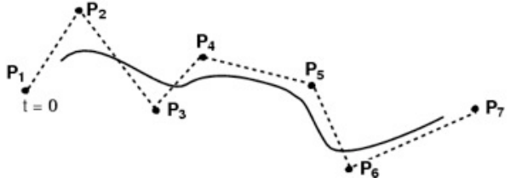
Cubic B-Splines
≥ 4 control points
Locally cubic
Cubics chained together, again

Slide 61
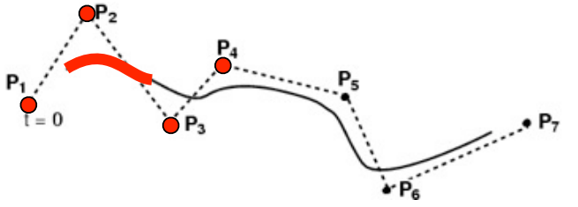
Cubic B-Splines
≥ 4 control points
Locally cubic
Cubics chained together, again

Slide 62
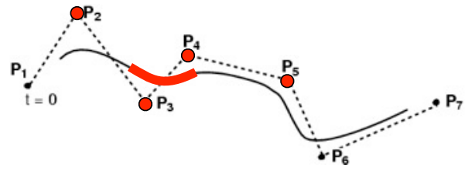
Cubic B-Splines
≥ 4 control points
Locally cubic
Cubics chained together, again

Slide 63
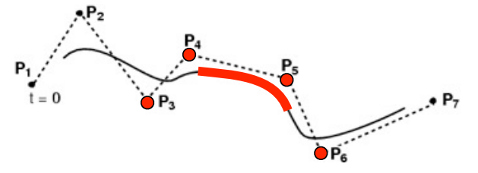
Cubic B-Splines
≥ 4 control points
Locally cubic
Cubics chained together, again

Slide 64
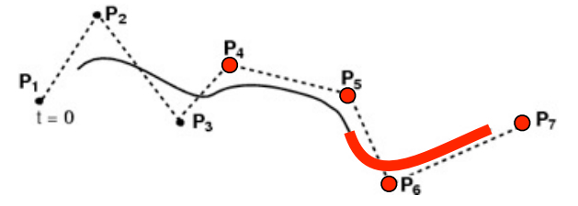
Cubic B-Splines
≥ 4 control points
Locally cubic
Cubics chained together, again

Slide 65
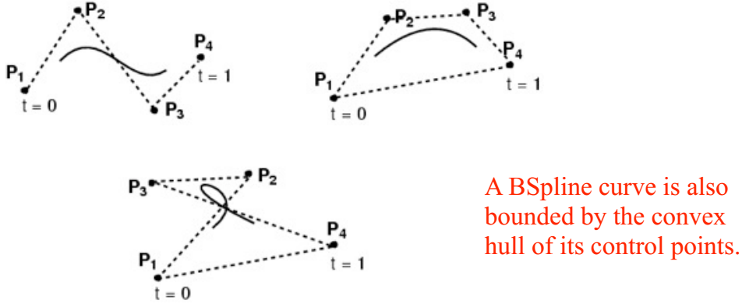
Cubic B-Splines
≥ 4 control points
Locally cubic
Curve is not constrained to pass through any control points

Slide 66
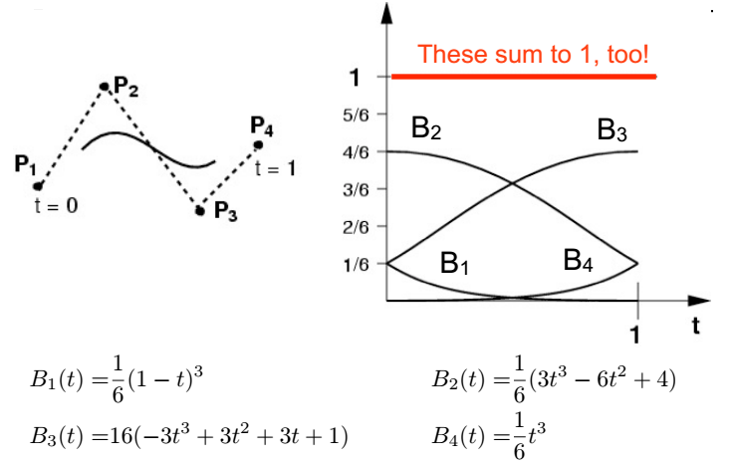
Cubic B-Splines: Basis

Slide 67
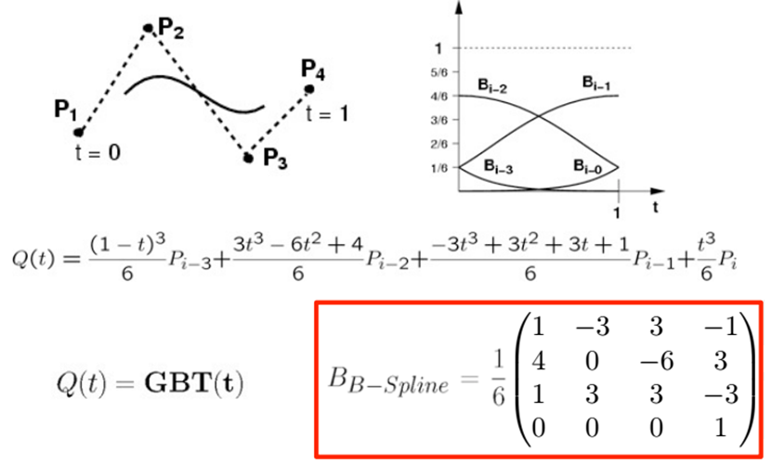
Cubic B-Splines: Basis

Slide 68
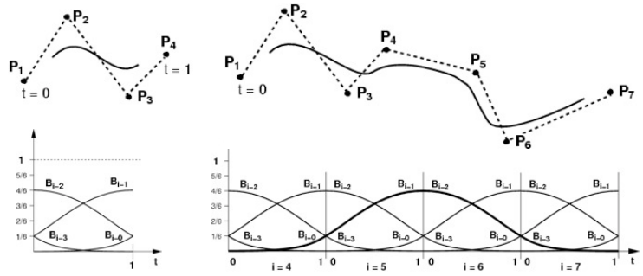
Cubic B-Splines
Local control (windowing)
Automatically C², and no need to match tangents!

Slide 69
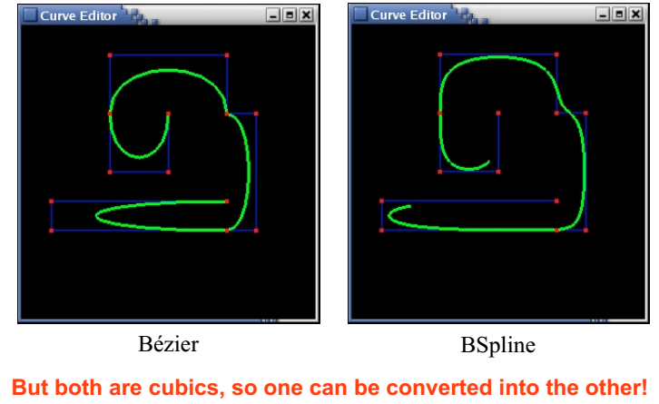
Bézier ≠ B-Spline

Slide 70
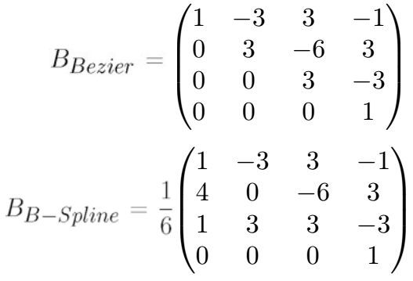
Converting between Bézier & BSpline
Simple with the basis matrices!
Note that this only works for a single segment of 4 control points
P(t) = GB₁T(t) = GB₁ (B₂⁻¹B₂) T(t)= (GB₁B₂⁻¹)B₂T(t)
GB₁B₂⁻¹ are the control points for the segment in new basis

Slide 71
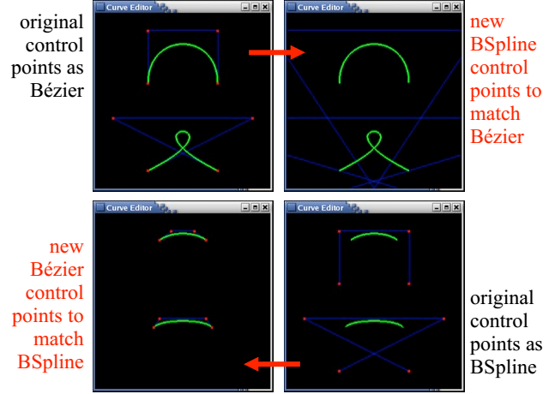
Converting between Bézier & BSpline

Slide 72
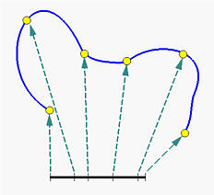
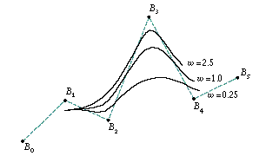
NURBS (Generalized B-Splines)
NURBS: Non-Uniform Rational B-Spline
non-uniform = different spacing between the blending functions, a.k.a. “knots”
rational = ratio of cubic polynomials
implemented by adding the homogeneous coordinate w into the control points.

